Slide 1

HIGH PERFORMANCE SRAM DESIGN FOR ENERGY EFFICIENT SYSTEMS
NARALASETTI UMESH SURYA KIRAN - 42130311 (A5)
VADDI UGANDHAR - 42130516 (B3)
Guided by:
Dr. T. RAVI, M.E., Ph.D.
Professor & Head
Dept. of Electronics and Communication Engineering
Sathyabama Institute of Science and Technology, Chennai

Slide 2

OVERVIEW
• Introduction
• Workflow
• Literature Survey
• Problem Definition
• Objectives
• Existing System
• Proposed System
• Block Diagram
• References

Slide 3
INTRODUCTION
• SRAM plays a critical role in low-power VLSI systems, especially for IoT and portable devices.
• Operating at ultra-low voltage (0.35V–0.6V) is essential for energy-efficient design.
• Conventional SRAM (6T, 8T) suffers from read stability issues, leakage, and high power in sub-threshold region.
• This project focuses on designing a 7T SRAM with Dynamic Read Assist and Adaptive Refresh to enhance speed and reduce leakage.

Slide 4

WORKFLOW
1. Literature Review
2. Design of 7T SRAM Cell in Cadence Virtuoso
3. Simulation for Read/Write, SNM, Power & Delay
4. Implement Dynamic Read Assist for speed improvement
5. Build 4×4 SRAM array with Adaptive Refresh
6. Compare performance with 6T and base 7T designs

Slide 5
Literature Survey – Part 1
S.No | Title & Year | Author(s) | Contribution | Inference
1 | A Low-Power Variation-Tolerant 7T SRAM With Enhanced Read Sensing Margin for Voltage Scaling (2024) | R. S. Shreedhar et al. | Proposed 7T SRAM for voltage scaling | Improved SNM but slow read speed
2 | A PMOS read-port 8T SRAM cell with optimized leakage power and enhanced performance (2023) | M. I. Shakil et al. | PMOS read port for leakage reduction | Needs precharge, larger area
3 | SRAM read and write assist apparatus (2023) | US Patent US8630132B2 | Assist circuits for read/write stability | Adds complexity and power

Slide 6
Literature Survey – Part 2
S.No | Title & Year | Author(s) | Contribution | Inference
4 | A replica technique for word line and sense control (2023) | R. Rajsuman | Replica column for timing optimization | Improves reliability but increases complexity
5 | Design and Analysis of Fast Low Power SRAMs (2023) | B. Amrutur, M. Horowitz | Optimized low-power SRAM design | Needs complex control circuits
6 | Multi-stage dual replica bit-line delay technique (2023) | Z. Liu et al. | Timing for low-voltage sensing | Area overhead, complexity

Slide 7
Literature Survey – Part 3
S.No | Title & Year | Author(s) | Contribution | Inference
7 | A Reconfigurable Replica Bitline to Determine Optimum SRAM Sense Amplifier Set Time (2022) | P. Panigrahi et al. | Adaptive sensing for timing optimization | Accurate but adds hardware complexity
8 | On the Efficacy of Write-Assist Techniques in Low Voltage Nanoscale SRAMs (2021) | K. Takeda et al. | Evaluates write-assist techniques | Improves write margin but power penalty
9 | Low Voltage and Low Power in SRAM Read and Write Assist Techniques (2021) | M. Kumar et al. | Comparison of assist schemes | Adds energy and design complexity

Slide 8

PROBLEM DEFINITION
• 6T SRAM fails in sub-threshold region due to read disturb and half-select issues.
• 8T SRAM reduces read disturb but has high leakage and requires precharge.
• 7T SRAM improves read margin but suffers from slow read speed at low voltage and standby leakage.
• Need for an SRAM design that is low power, variation-tolerant, faster, and leakage-optimized.

Slide 9
OBJECTIVES
• Design and simulate a 7T SRAM cell in Cadence Virtuoso.
• Add Dynamic Read Assist to improve read speed (~40% faster).
• Implement Adaptive Refresh in a small array to minimize leakage (~90% reduction).
• Compare performance (power, delay, SNM) with 6T and original 7T designs.

Slide 10

EXISTING SYSTEM
• 6T SRAM:
- Simple, widely used, but fails at low voltage.
• 8T SRAM:
- Adds a read port for stability but suffers from high leakage and power overhead.
• Both require assist techniques for ultra-low voltage, adding complexity and area.

Slide 11
PROPOSED SYSTEM
• Base: 7T SRAM for low power and variation tolerance.
• Add Dynamic Read Assist:
- Boost read speed by ~40% at low voltage.
• Add Adaptive Refresh in small SRAM array:
- Reduce standby leakage by ~90%.
• Target: Reliable operation at 0.35V with energy efficiency.

Slide 12
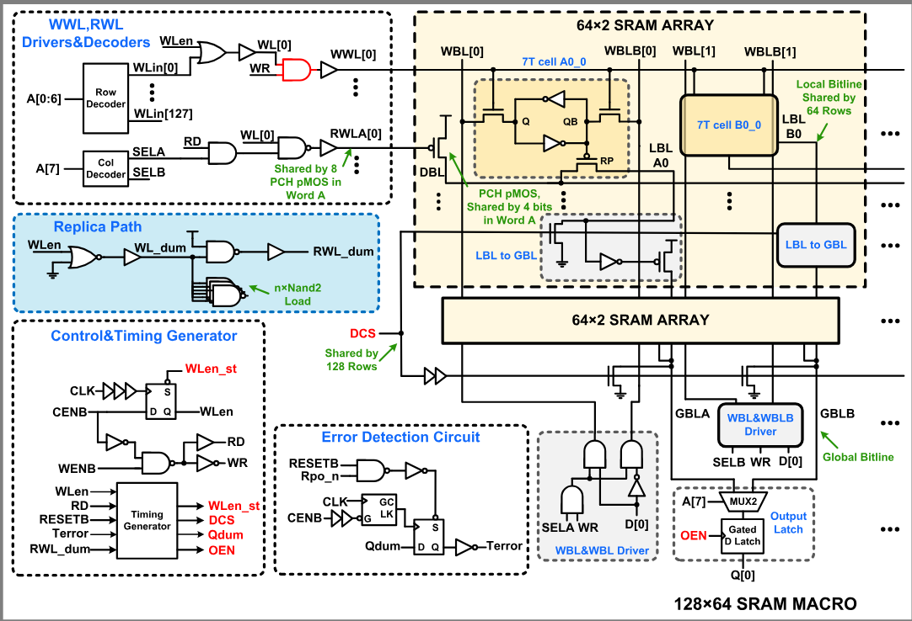
BLOCK DIAGRAM

Slide 13
Parameter | 6T SRAM | 7T SRAM | Comments
Transfer Curve Shape | Steep switching | Steep switching, slightly smoother | Both show cross-coupled inverter behavior
Butterfly Curve | Standard symmetrical butterfly | Similar but with slight asymmetry | Indicates static noise margin and symmetry
Static Noise Margin (SNM) | Visual: ~0.60–0.70V box (from butterfly) | Visual: ~0.70–0.80V box (from butterfly) | 7T shows slightly better SNM (wider squares)
Inverter Slope (Q/QB vs V<sub>in</sub>) | Crossover near 0.9V, sharp | Crossover near 0.9V, appears slightly more gradual | Both cells switch around same point; 7T may offer smoother transition
Write Margin | Standard (from normal inverters) | Appears improved (flatter tail region) | 7T may allow easier overwriting in weak condition
Read Disturb | Typical (do not see heavy offset) | Flatter in low region | 7T may offer better read stability
Hysteresis / Loop Area | Moderate | Slightly larger | 7T's butterfly curve area is slightly increased

Slide 14
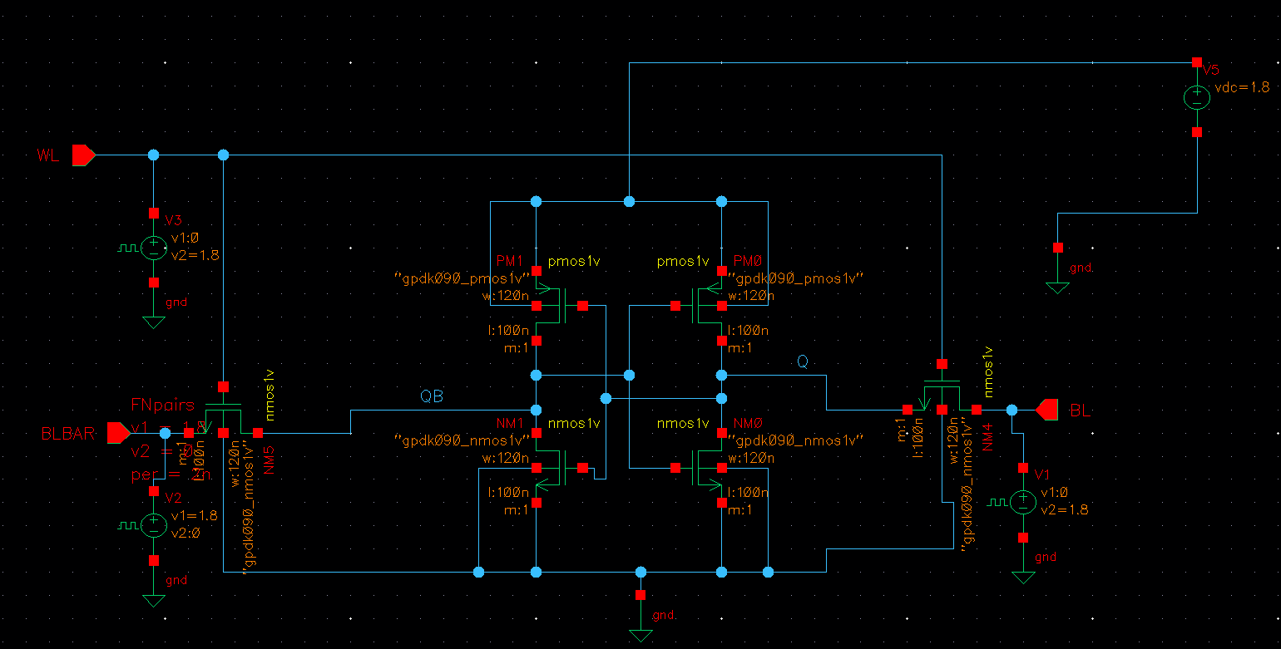
CIRCUIT DIAGRAMS

Slide 15
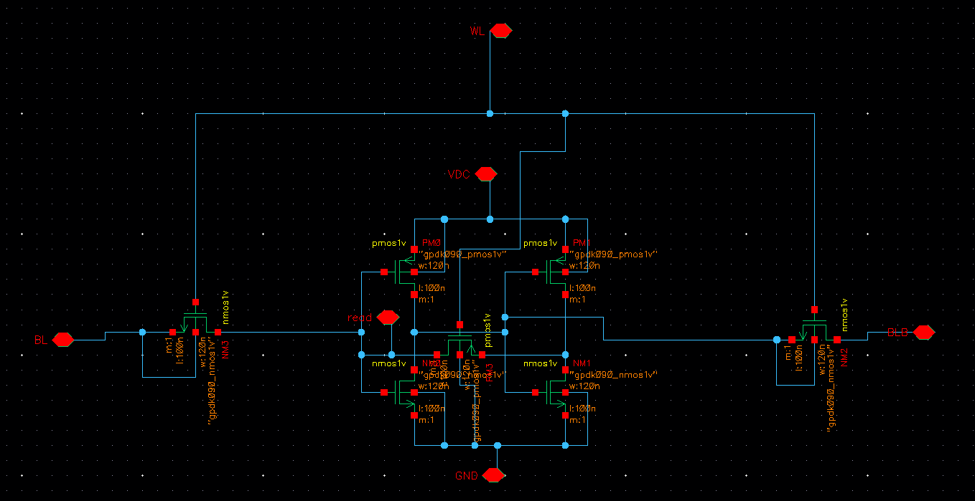

Slide 16
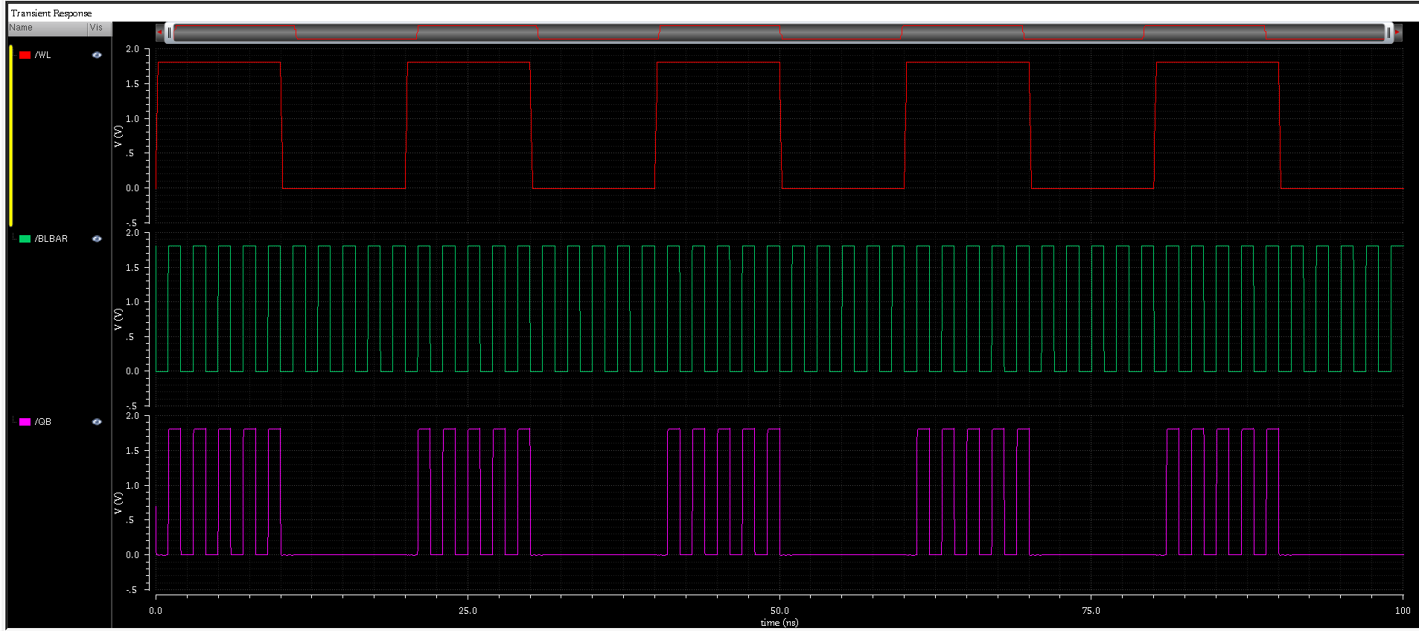
OTPUTS

Slide 17
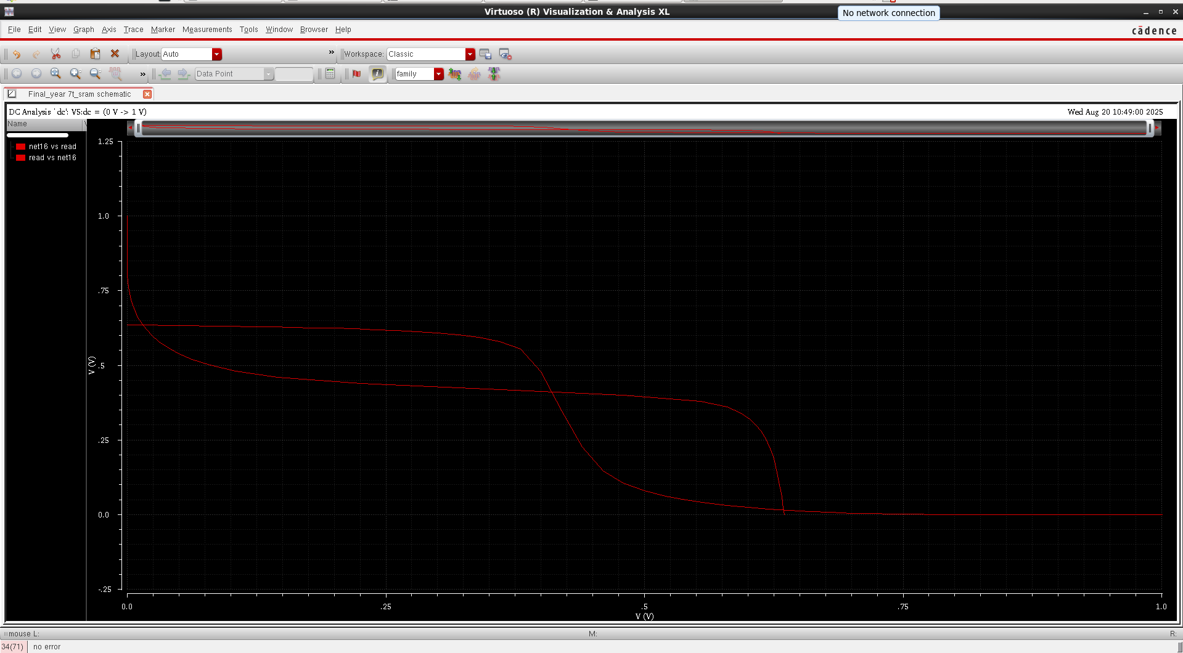

Slide 18
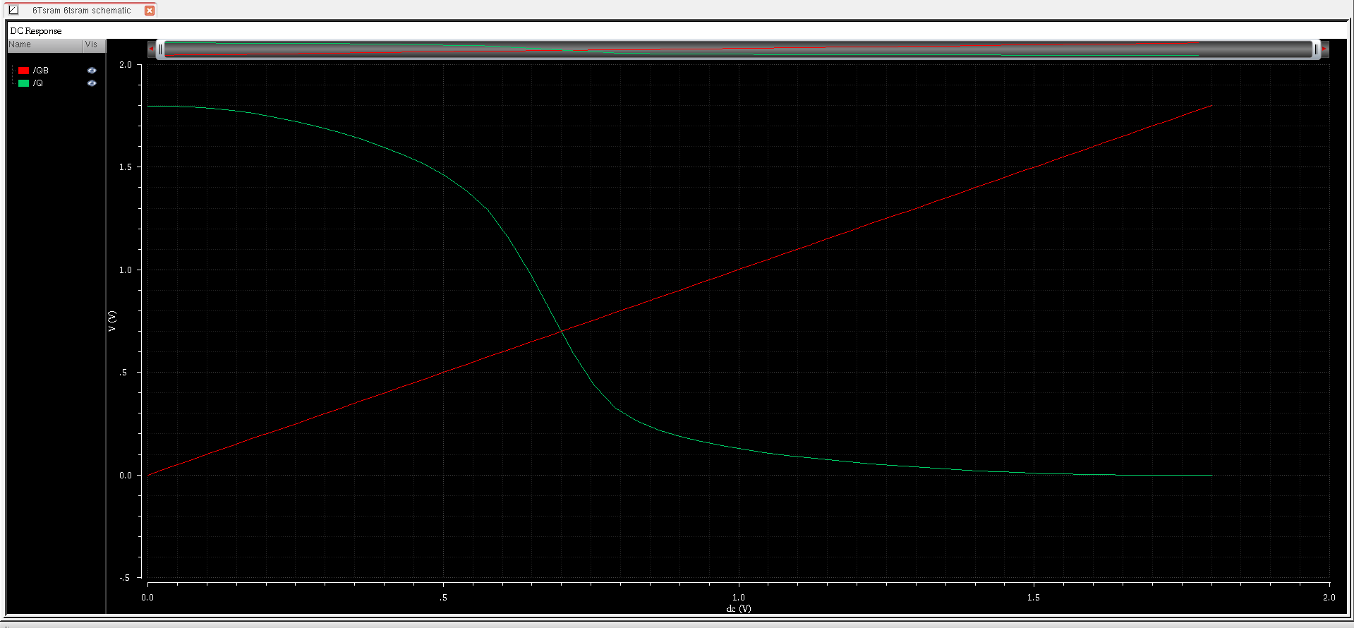

Slide 19
EXPECTED ADVANTAGES
• ~40% faster read at 0.35V compared to original 7T.
• Standby leakage reduced by ~90% with refresh.
• Power remains ~30% of 6T design (due to no bitline precharge).
• High SNM and stability across PVT variations.

Slide 20
REFERENCES
[1] A Low-Power Variation-Tolerant 7T SRAM With Enhanced Read Sensing Margin for Voltage Scaling.
[2] A PMOS read-port 8T SRAM cell with optimized leakage power and enhanced performance.
[3] US8630132B2 - SRAM read and write assist apparatus - Google Patents.
[4] A replica technique for wordline and sense control in low-power SRAMs.
[5] DESIGN AND ANALYSIS OF FAST LOW POWER SRAMs - Stanford VLSI research group.
[6] Multi-stage dual replica bit-line delay technique for process-variation-robust timing of low voltage SRAM sense amplifier.
[7] A Reconfigurable Replica Bitline to Determine Optimum SRAM Sense Amplifier Set Time.
[8] On the Efficacy of Write-Assist Techniques in Low Voltage Nanoscale SRAMs.
[9] Low Voltage and Low Power in SRAM Read and Write Assist Techniques - IJSTE.

Slide 21

THANK YOU

